Slide 1

.Net Programming using C#
Assignment 4

Slide 2

STEP 2: CREATE YOUR FIRST ASP.NET CORE WEB APP

Slide 3
1> To get Server Time
Index.cshtml.cs
using System;
using System.Collections.Generic;
using System.Linq;
using System.Threading.Tasks;
using Microsoft.AspNetCore.Mvc;
using Microsoft.AspNetCore.Mvc.RazorPages;
namespace Assignment_4.Pages
{
public class IndexModel : PageModel
{
public string Time { get; set; }
public void OnGet()
{
Time = DateTime.Today.ToShortTimeString();
}
}
}
Index.cshtml
@page
@model IndexModel
@{
ViewData["Title"] = "Home page";
}
<h2> It's @Model.Time right now on the server!</h2>

Slide 4
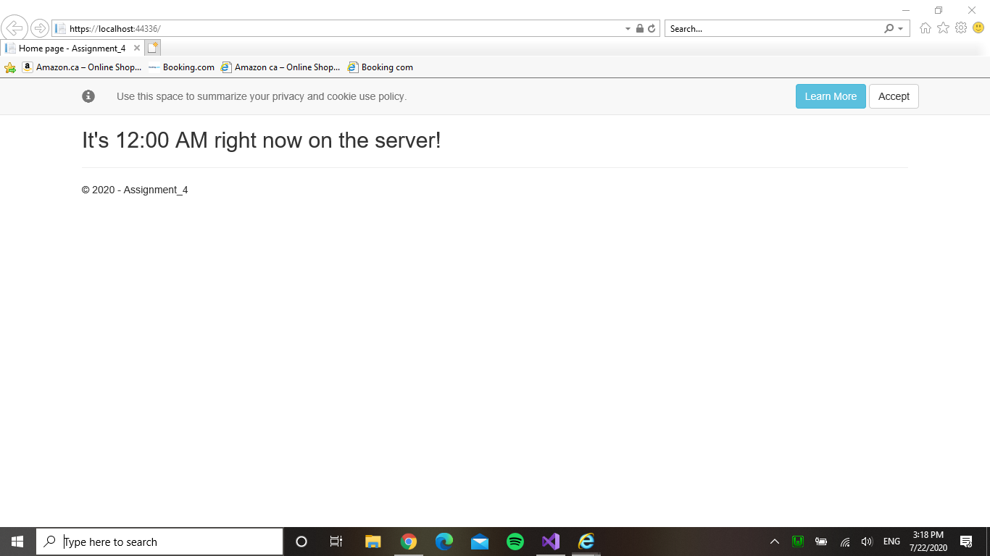
Output

Slide 5
2> To get Local Time
Index.cshtml.cs
using System;
using System.Collections.Generic;
using System.Linq;
using System.Threading.Tasks;
using Microsoft.AspNetCore.Mvc;
using Microsoft.AspNetCore.Mvc.RazorPages;
namespace Assignment_4.Pages
{
public class IndexModel : PageModel
{
public string Time { get; set; }
public void OnGet()
{
Time = DateTime.Now.ToShortTimeString();
}
}
}

Slide 6
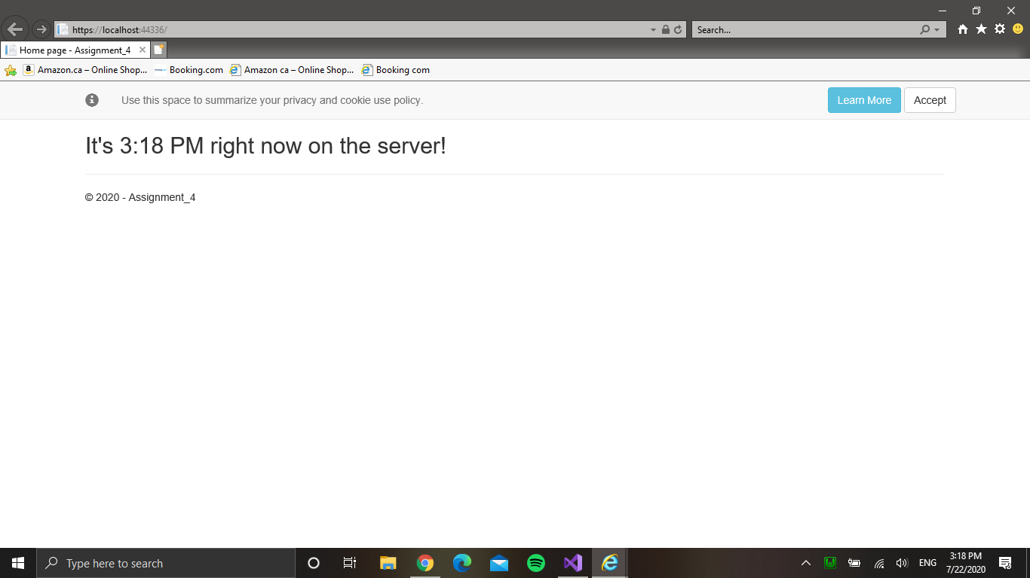
Output

Slide 7
Step 3: Work with data using Entity Framework

Slide 8
After following Step 3
Created Models Folder
Added Game.cs in Models
Created Games Folder in Pages Folder
Added CRUD files in the folder
Made some changes in Program.cs

Slide 9
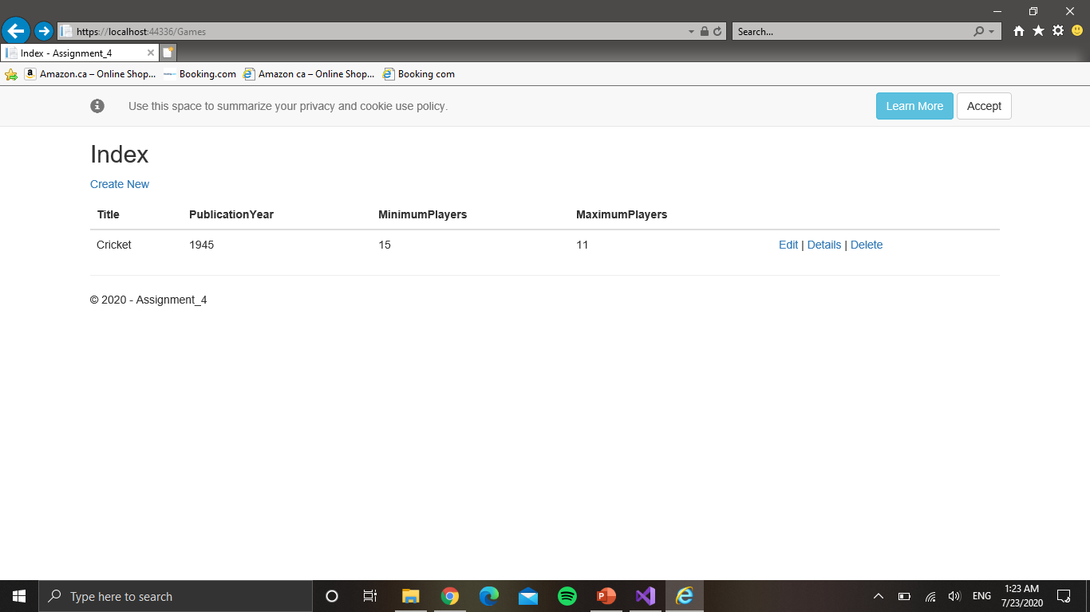
Output

Slide 10
Step 4: Expose a web API from your ASP.NET Core app

Slide 11
Add an API controller
Added API Controller with:
Get
Put
Post
Delete
Adding Swagger

Slide 12
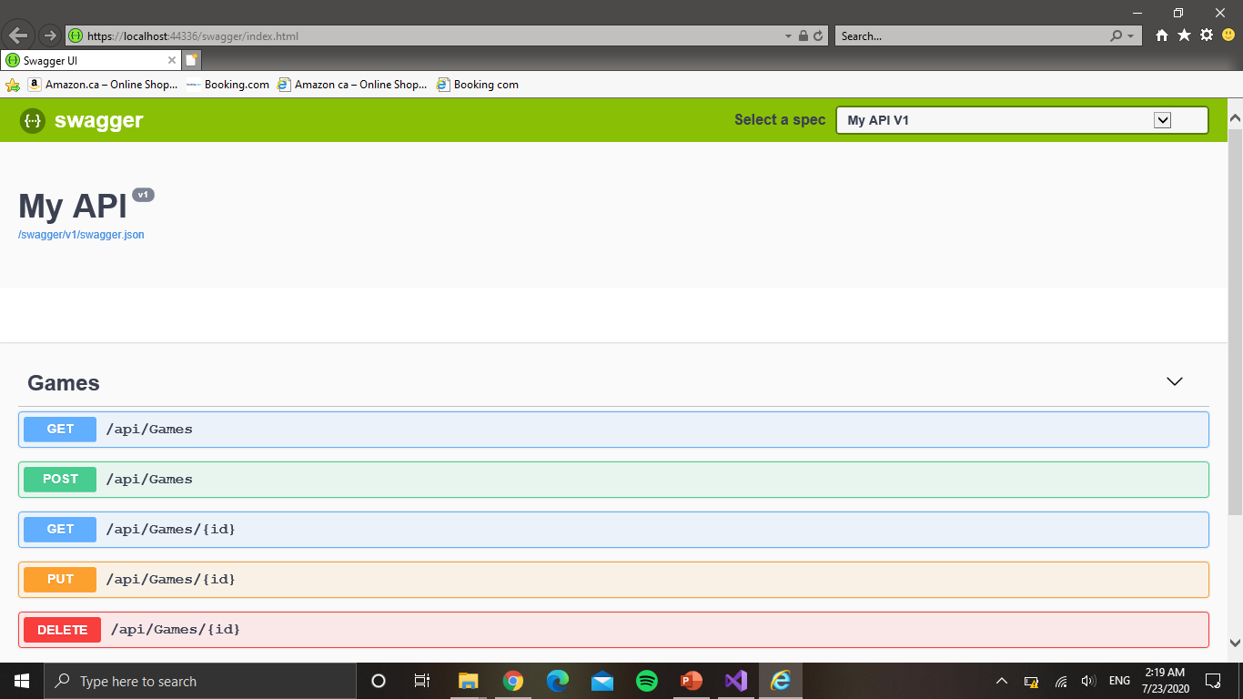
Output:

